Slide 1


ABHAY MAHAJAN
B.Tech. IIT Roorkee
11+ years teaching experience
Mentored and taught around 20000+ students
Produced 400+ IIT selections
10+ INMO selections
1 EGMO Selection

Slide 2


Slide 3



Slide 4

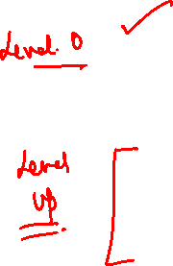

Slide 5



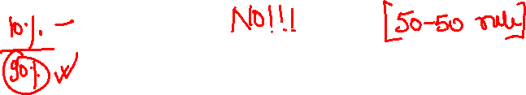
Kindly attempt the Session Assignment
that follows
NOTE: Solution also attached

Slide 6
Divisibility Rule

Slide 7
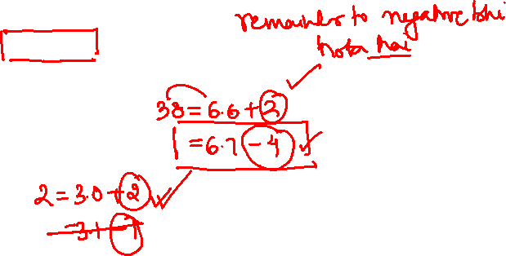
Euclid’s division lemma
For any pair of positive integers a and b there exist a pair of unique integers q and r such that
a = b × q + r , where 0 ≤ r < b
Here q is the quotient and r is the remainder obtained when a is divided by b.
Ex. if a = 38 and b = 6
38 = 6 × 6 + 2
Ex. If a= 2 and b = 3
2 = 0 × 3 + 2

Slide 8
DIVISION ALGORITHM
Can we write it like this?
25 = 3 x 8 + 1
8
3
25
Dividend
24
Divisor
1
Quotient
Remainder
Dividend = Divisor x Quotient + Remainder
Dividend = Divisor x Quotient + Remainder

Slide 9

FACTS
Quotient q is a positive integer when a is greater than or equal to b.
Quotient q is 0 when a is less than b.
Remainder r is a whole number whose value is less than b i.e., 0 ≤ r < b

Slide 10

Divisibility Tests
Divisibility by 2: If the last digit of a number
is 0 or an even number, then the number is divisible by 2.
Ex: 252, 430 etc.
Divisibility by 3: If the sum of all the digits
of a number is divisible by 3, then the number is divisible by 3.
Ex: 432, 4 + 3 + 2 = 9 which is divisible by 3.
Divisibility by 4: If in any number, last two
digits are divisible by 4, then the number is divisible by 4.
Ex: 48124, 24 is divisible by 4.

Slide 11
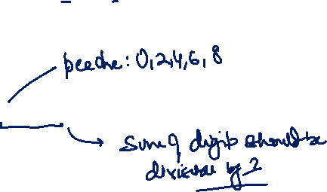
Divisibility Tests
4. Divisibility by 5: If the last digit of a number is 5 or 0, then the number is divisible by 5.
Ex: 1200, 2365.
5. Divisibility by 6: If a number is divisible by both 2 and 3, then the number is divisible by 6.
Ex: 432

Slide 12
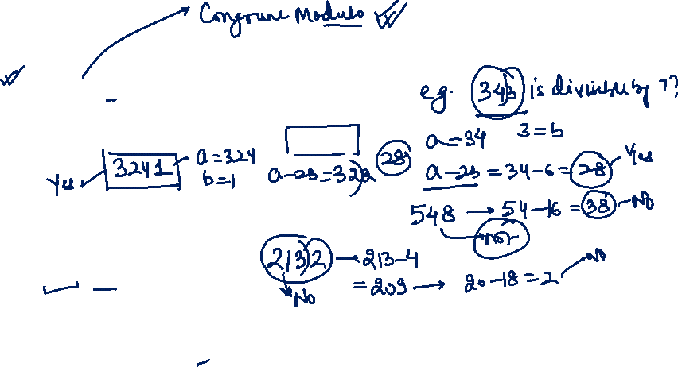
Divisibility Tests
6. Divisibility by 7: Let ab be a number. (where b is unit digit and a represents the remaining digits). Then it is divisible by 7 if a – 2b is divisible by 7.
7. Divisibility by 8: If in any number, last three digits are divisible by 8, then the number is divisible by 8.
Ex: 247864, 864 is divisible by 8.
8. Divisibility by 9: If the sum of all the digits of a number is divisible by 9, then the number is divisible by 9.
Ex: 243243, 2 + 4 + 3 + 2 + 4 + 3 = 18 which is divisible by 9.

Slide 13
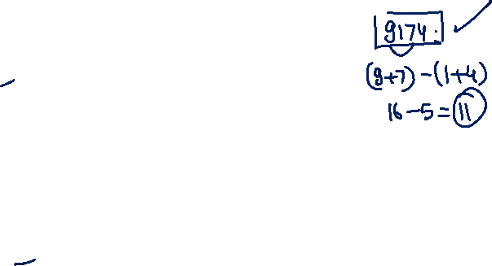
Divisibility Tests
9. Divisibility by 10: If the last digit of a number is 0, then the number is divisible by 10.
10. Divisibility by 11: If the difference
between the sum of the odd-numbered
digits and the sum of the even-numbered
digits, counted from right to left, is
divisible by 11, then the number is divisible
by 11.
Ex: 9174, (9 + 7) - (1 + 4) = 16 - 5 = 11 which is divisible by 11.

Slide 14
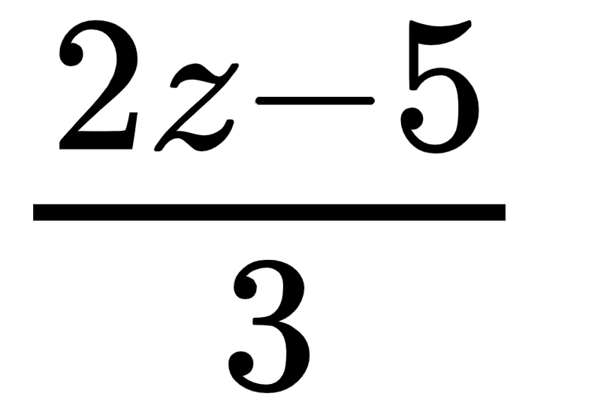
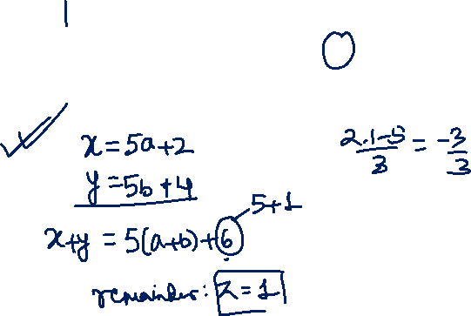
NTSE 2015
Q. When a natural number x is divided by 5, the remainder is 2. When a natural number y is divided by 5, the remainder is 4. The remainder is z when
x + y is divided by 5. The value of is
A
–1
B
1
C
–2
D
2

Slide 15
NTSE 2015
Q. When a natural number x is divided by 5, the remainder is 2. When a natural number y is divided by 5, the remainder is 4. The remainder is z when
x + y is divided by 5. The value of is
A
–1
B
1
C
–2
D
2

Slide 16

Solution :
When a natural number x is divided by 5, the remainder is 2
∴ x = 5P + 2 …(i)
When a natural number y is divided by 5 the remainder is 4
∴ y = 5Q + 4 ...(ii)
When x + y is divided by 5 the remainder is z
Adding Eq. (i) and (ii), we get
x + y = 5 (P + Q) + 6
Now when x + y is divided by 5, remainder will be 1
z = 1
Hence the value of

Slide 17
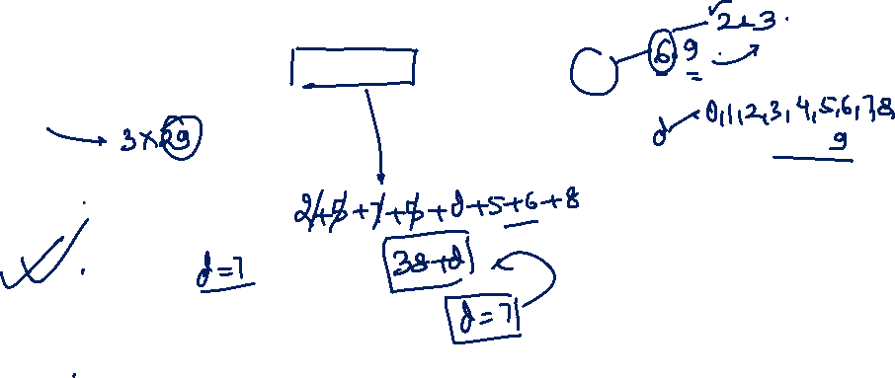
NTSE 2012
Q. If the eight digit number 2575d568 is divisible by 54 and 87, the value of the digit ‘d’ is
A
4
B
7
C
0
D
8

Slide 18
NTSE 2012
Q. If the eight digit number 2575d568 is divisible by 54 and 87, the value of the digit ‘d’ is
A
4
B
7
C
0
D
8

Slide 19
Solution :
54 = 2 × 3 × 3 × 3 = 2 × 3³
87 = 3 × 29
2575d568 is divisible by 54 & 87
Hence it should also be divisible by 2, 3 & 29
Divisible by 2 → Even Number
Divisibility by 3
2 + 5 + 7 + 5 + d + 5 + 6 + 8 = 38 + d
Hence d can be 1, 4, 7
If d = 1 or 4
25751568 and 25754568 are not divisible by 29
Hence d = 7 is TRUE

Slide 20
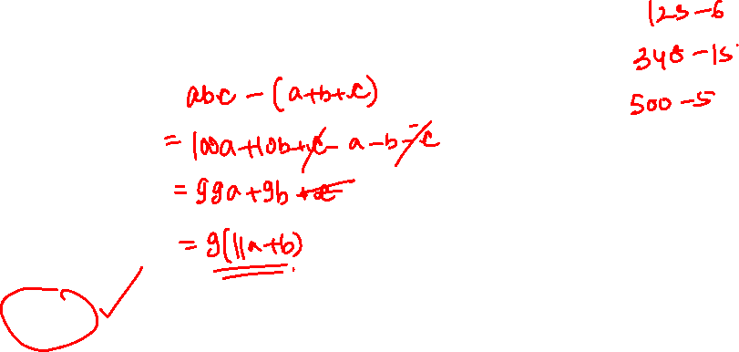
NTSE 2013
Q. If sum of digits of any integer lying between 100 and 1000 is subtracted from that integer, then the result is always divisible by which number?
A
7
B
6
C
5
D
9

Slide 21
Q. If sum of digits of any integer lying between 100 and 1000 is subtracted from that integer, then the result is always divisible by which number?
NTSE 2013
A
7
B
6
C
5
D
9

Slide 22
Solution :
let the three digit number of abc
Where abc = 100a + 10b + c
Therefore,
(100a + 10b + c ) – (a + b + c) = 99a + 9b = 9 (11a + b) which is divisible by 9
Therefore, when a + b + c is subtracted from the integer, the result is always divisible by 9

Slide 23
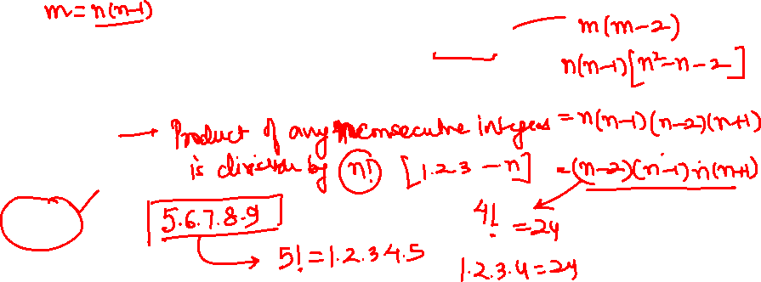
NTSE 2019
Q. If m = n² – n, where n is an integer then m² – 2m is divisible by
A
20
B
24
C
30
D
16

Slide 24
NTSE 2019
Q. If m = n² – n, where n is an integer then m² – 2m is divisible by
A
20
B
24
C
30
D
16

Slide 25
Solution :
We can solve this question by taking arbitrary value of n.
If we take n = 3, we get m = 9 - 3 = 6 , Now
m² – 2m = 36 – 12 = 24
24 is not divisible by 20, 30 and 16.
Hence option (B) is correct.

Slide 26
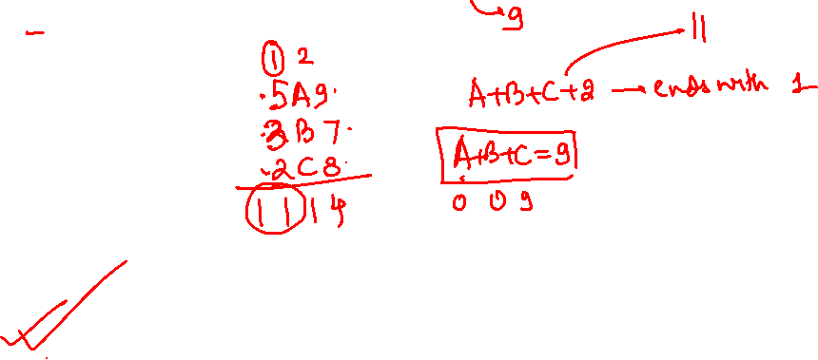
NTSE 2014 –15
Q. Given 5A9 + 3B7 + 2C8 = 1114, then the maximum value of C is
A
5
B
7
C
8
D
None of these

Slide 27
NTSE 2014 –15
Q. Given 5A9 + 3B7 + 2C8 = 1114, then the maximum value of C is
A
5
B
7
C
8
D
None of these

Slide 28
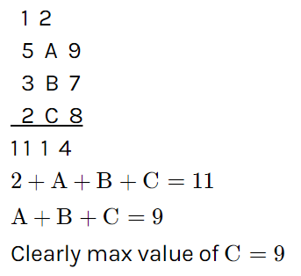
Solution :

Slide 29
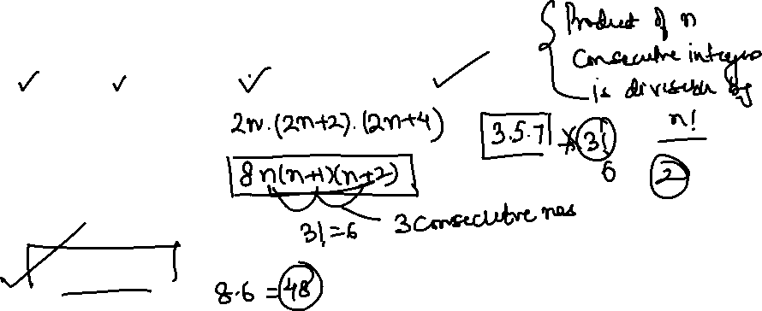
Q. Product of any three consecutive even numbers is divisible by
I. 2, II. 4, III. 12, IV. 16
NTSE 2019
A
I and II
B
I, II and III
C
I, II, III and IV
D
II and IV

Slide 30
Q. Product of any three consecutive even numbers is divisible by
I. 2, II. 4, III. 12, IV. 16
NTSE 2019
A
I and II
B
I, II and III
C
I, II, III and IV
D
II and IV

Slide 31
Solution :
Three even consecutive numbers are
2n, (2n + 2), (2n + 4)
Product of
2n(2n + 2)(2n + 4) = 8n(n + 1) (n + 2)
If we take n = 1, and substitute in
8n(n + 1) (n + 2),
n(n + 1) (n + 2) is divisible by 3!.

Slide 32
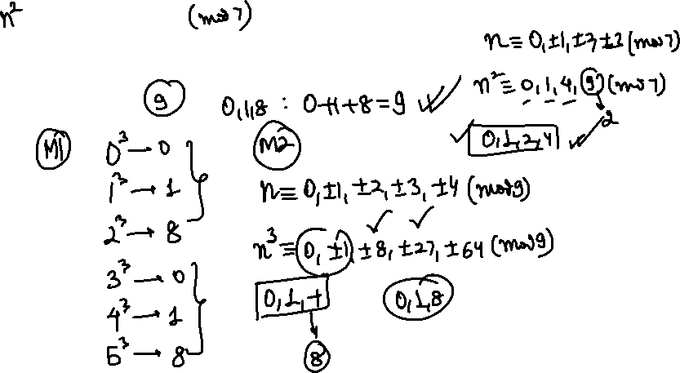
NTSE 2017
Q. The sum of all the possible remainders, which can be obtained when the cube of a natural number is divided by 9, is
A
5
B
6
C
8
D
9

Slide 33
NTSE 2017
Q. The sum of all the possible remainders, which can be obtained when the cube of a natural number is divided by 9, is
A
5
B
6
C
8
D
9

Slide 34
Solution :
When 1³ is divided by 9 then remainder is 1
When 2³ is divided by 9 then remainder is 8
When 3³ is divided by 9 then remainder is 0
When 4³ is divided by 9 then remainder is 1
This Pattern started repeating after 3
Hence, all possible remainders are 0, 1 and 8
∴ Sum of remainders = 0 + 1 + 8 = 9

Slide 35
Kindly attempt the Session Assignment
that follows
NOTE: Solution also attached

Slide 39

If you liked the session, then

